Slide 1

PORTFOLIO MANAGEMENT
FUND-A-MENTALS
Zeeshan Khan
R Haritha
K Prathyusha

Slide 2
ABOUT THE PROJECT:
This project aims to develop a user-friendly portfolio management system that enables users to easily retrieve and manage stock-related operations. The system is built using HTML, CSS, JavaScript, MySQL, and Express.

Slide 3
TECHNOLOGIES USED:
Front-end : HTML,CSS,Bootstrap,JS
Back-end : Express,SQL,JS
Database : MySQL.

Slide 4
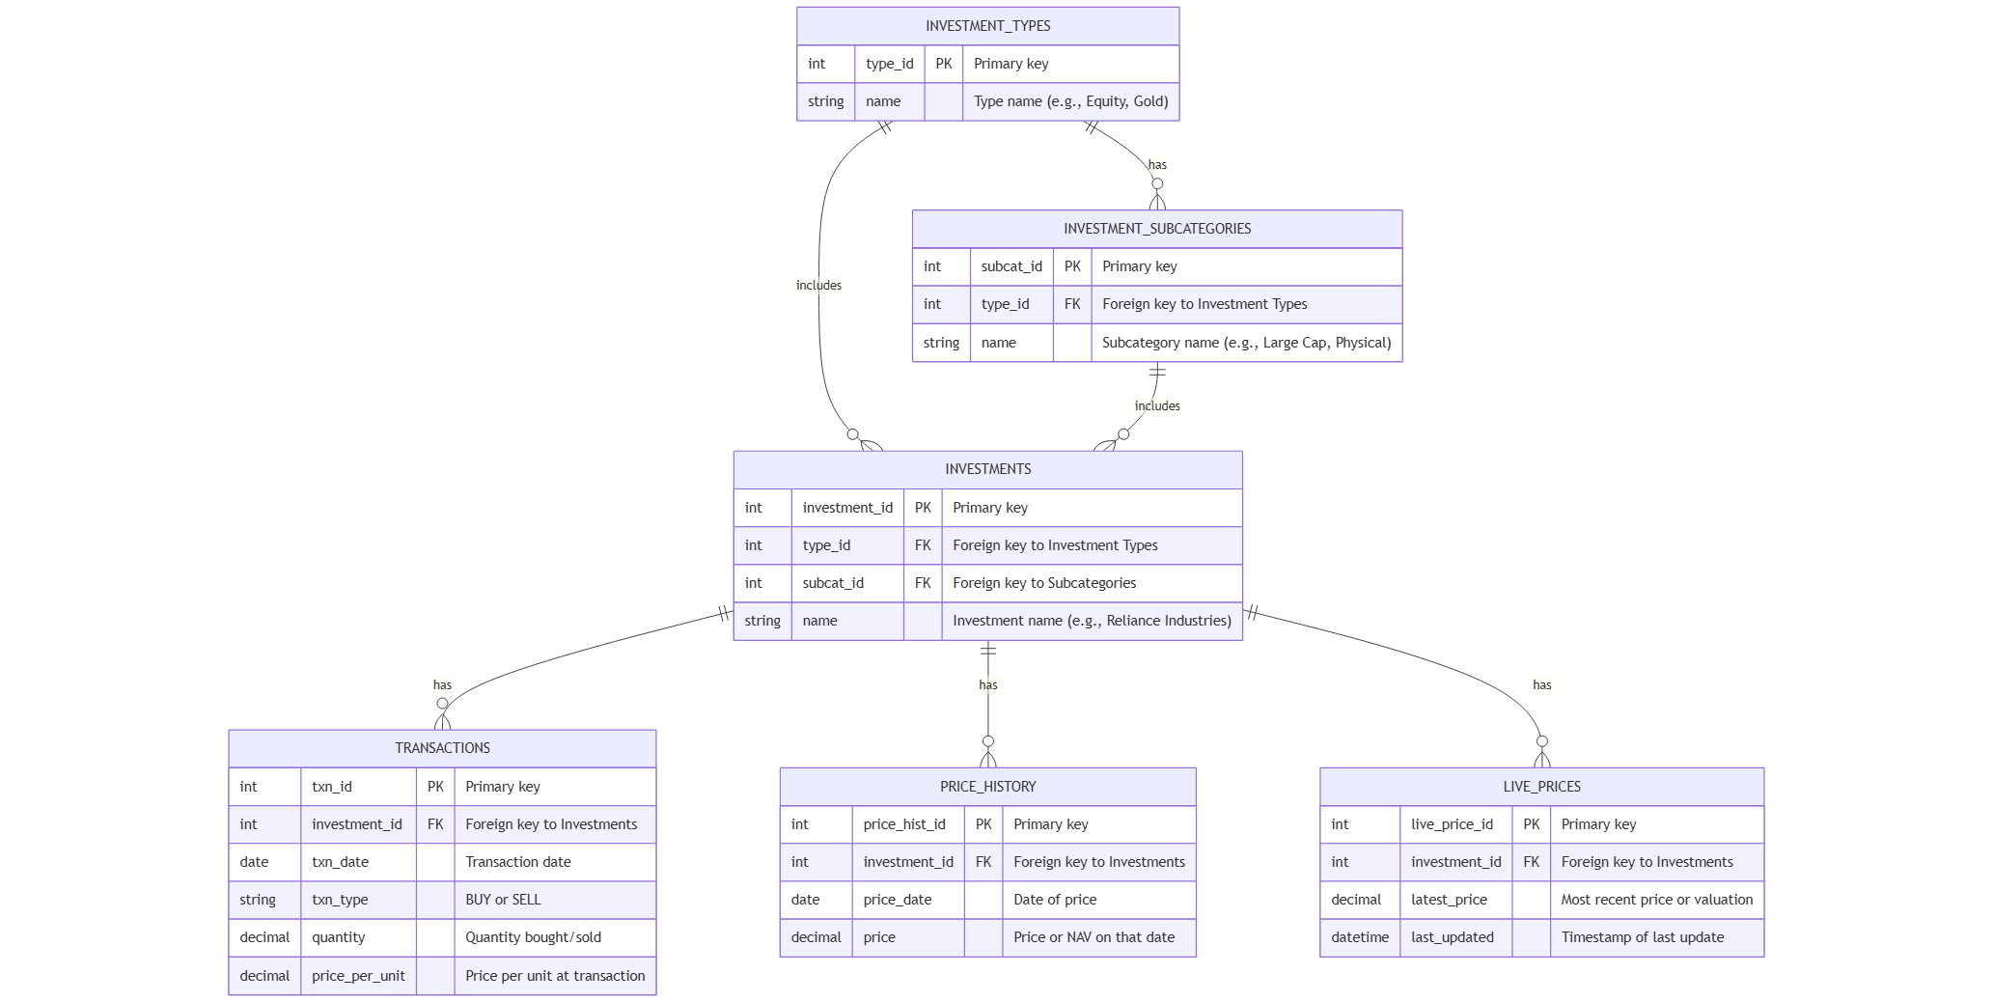
DB Schema:

Slide 5
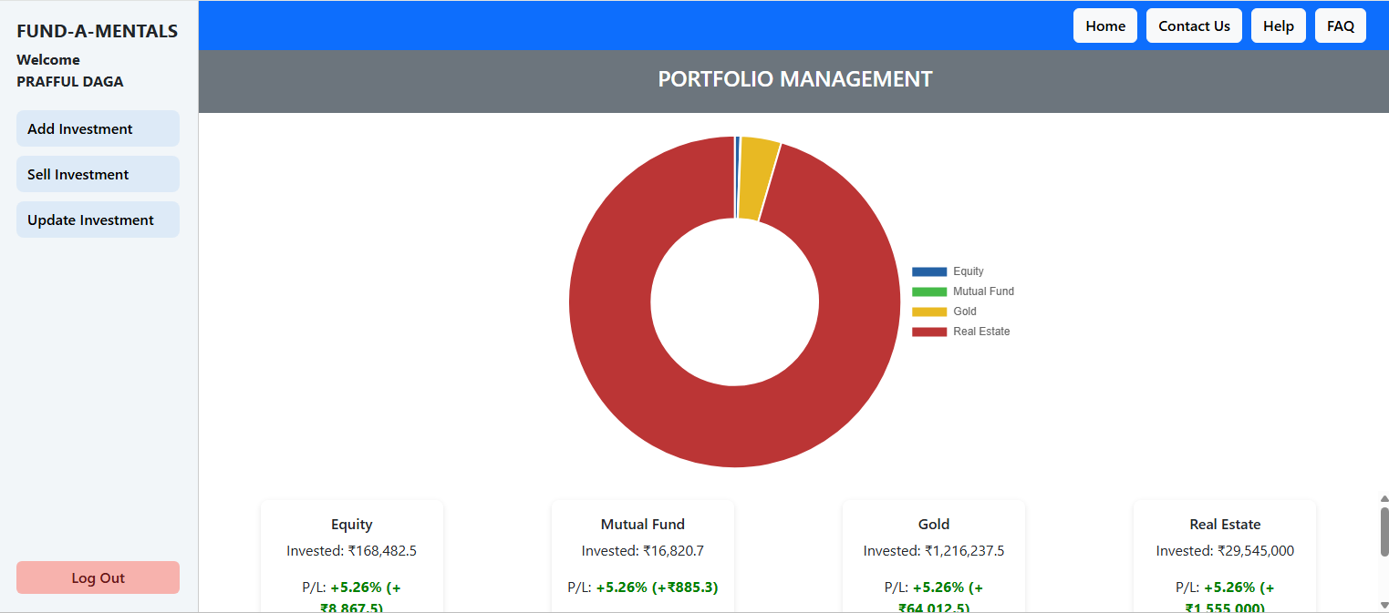
UI Screens:

Slide 6
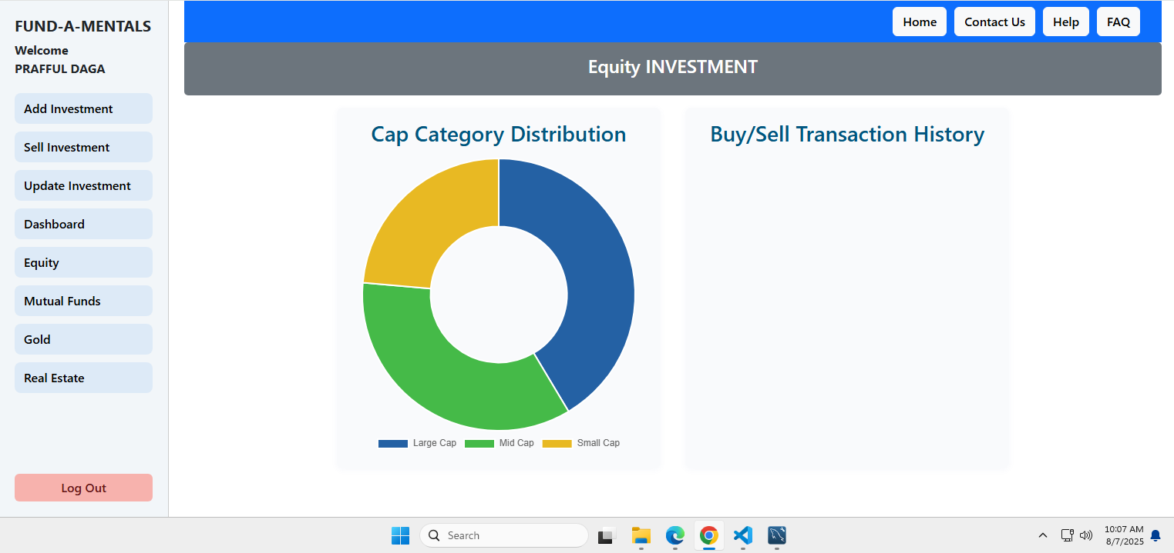

Slide 7
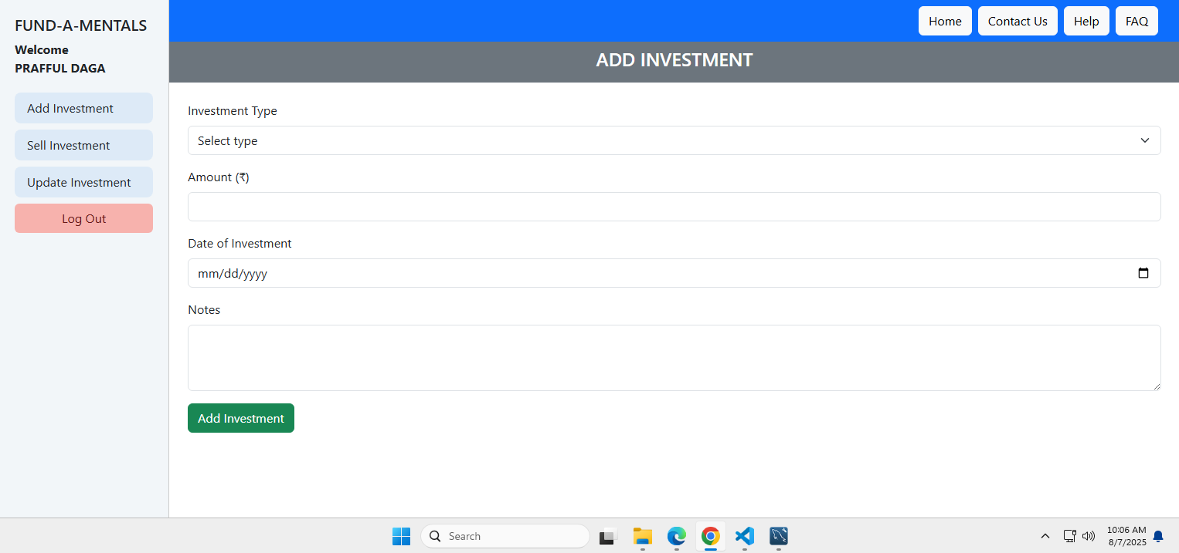

Slide 8
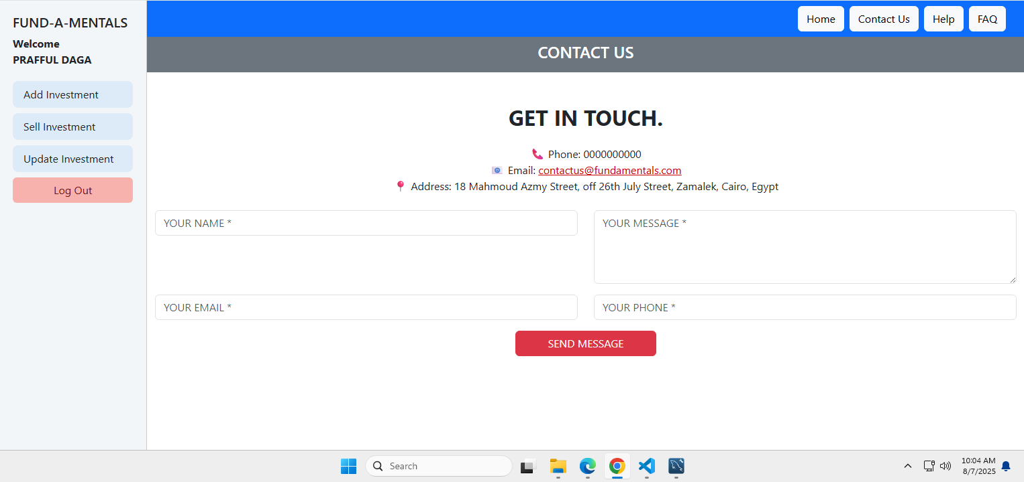

Slide 9
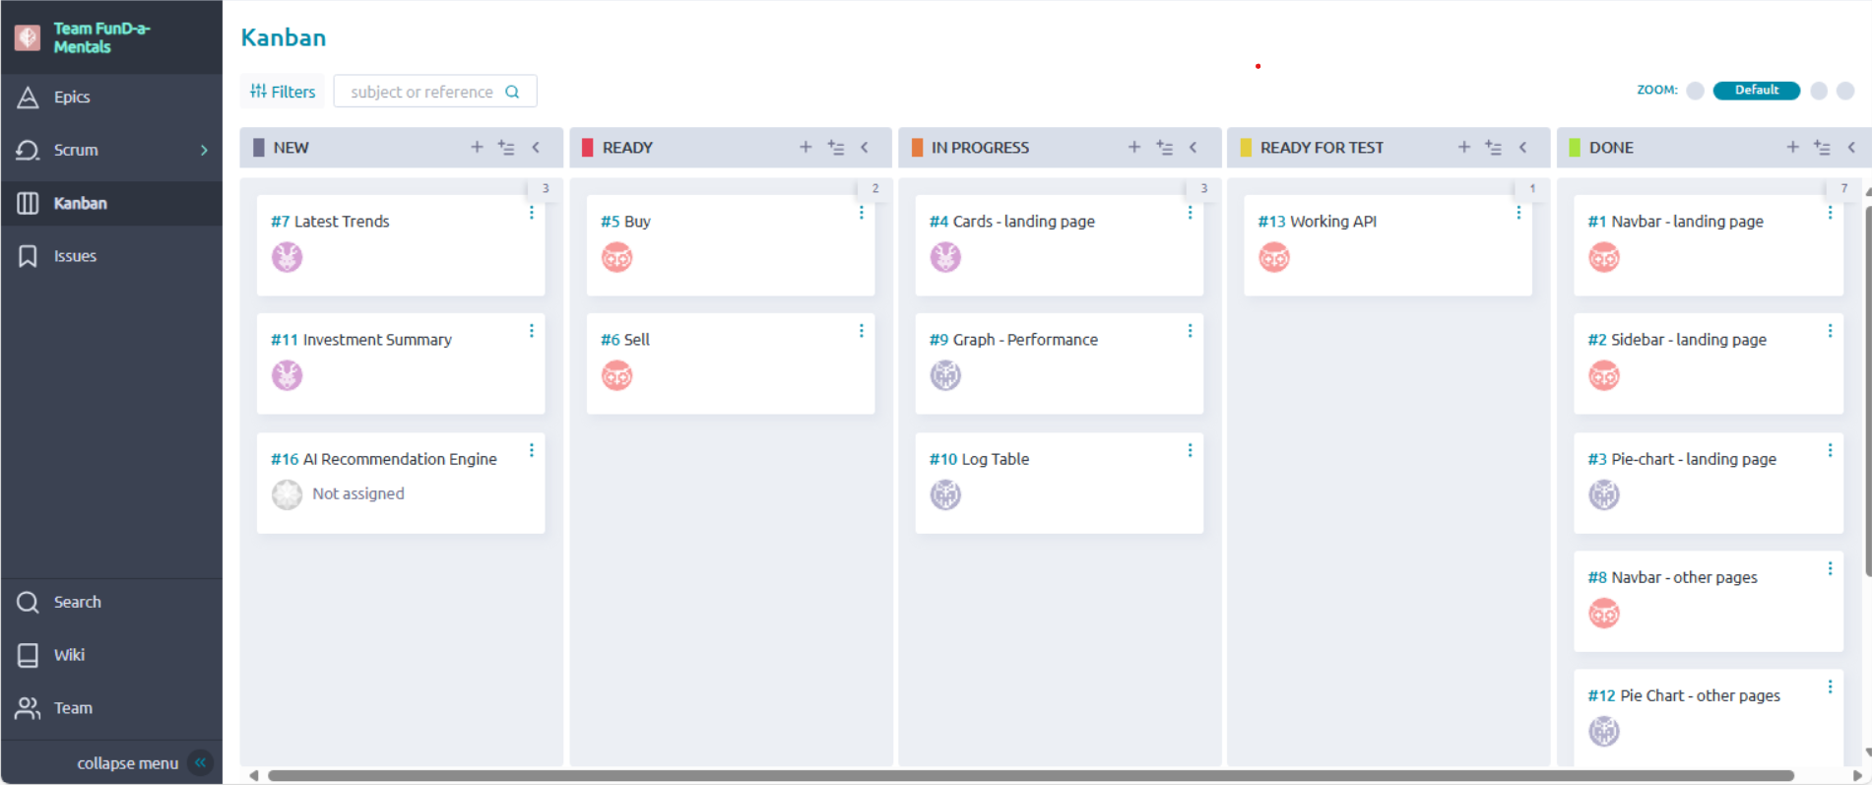
KANBAN:
Link:https://tree.taiga.io/project/prafful-team-fund-a-mentals/kanban

Slide 10
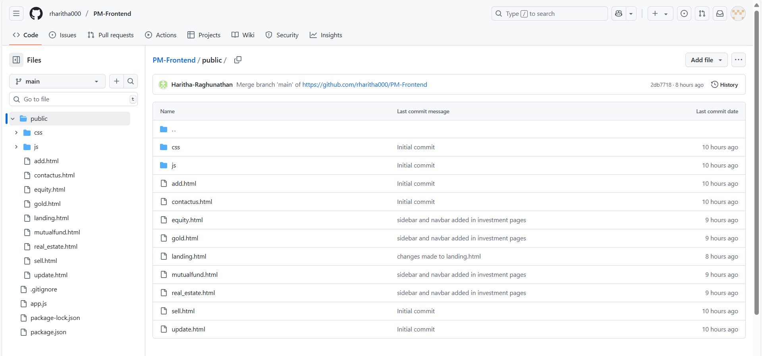
GITHUB:
LINK:https://github.com/rharitha000/PM-Frontend/tree/main/public

Slide 11
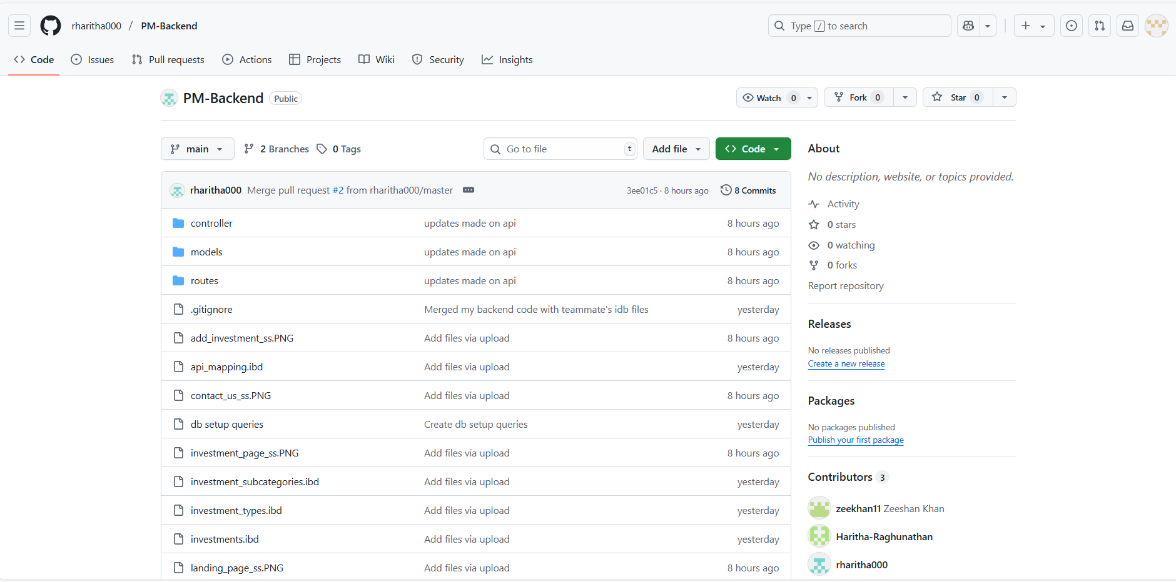
LINK:https://github.com/rharitha000/PM-Backend

Slide 12
FUTURE SCOPE:
Latest Trends
AI Recommendation Engine

Slide 13
FUTURE ENHANCMENTS:
Improve the UI/UX performance.
Implement the update investments.
Include the line charts for the cards.

Slide 14
CONCLUSIONS:
Effectively utilized the API for various functionalities.
Encountered challenges while integrating the frontend with the backend.
Faced some difficulties with database operations and continuously worked on improving SQL skills.
Made significant progress in enhancing the user interface for a better user experience.

Slide 15
THANK YOU

